Slide 1
SIGNAL DEGRADATION IN FIBER OPTICS

Slide 2
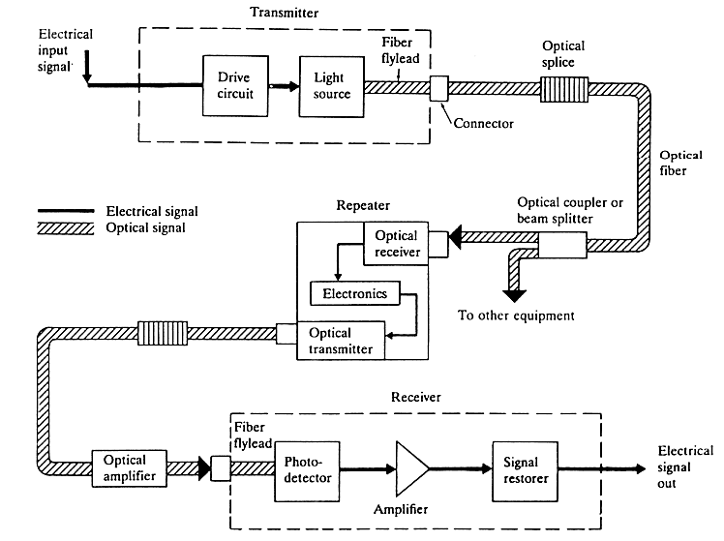
Key Elements of Optical Fiber Systems

Slide 3
A Fiber-Optic System
fiber
Transmitter
Optical
Amplifier
Receiver
Optional

Slide 4
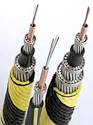
Advantages of Optical Fiber
Enormous capacity
Low transmission loss
Cables and equipment have small size and weight
A large number of fibers fit easily into an optical cable
Applications in special environments as in aircrafts, satellites, ships
Immunity to interference
Nuclear power plants, hospitals, EMP (Electromagnetic pulse) resistive systems (installations for defense)
Electrical isolation
electrical hazardous environments
negligible crosstalk
Signal security
banking, computer networks, military systems
Silica fibers have abundant raw material
Corning’s standard submarine cables can have up to 144 fibers in a single cable housing

Slide 5
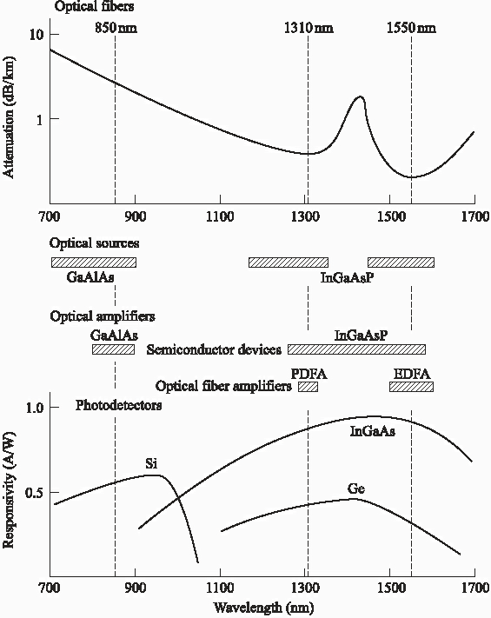
Operating Ranges of Components

Slide 6
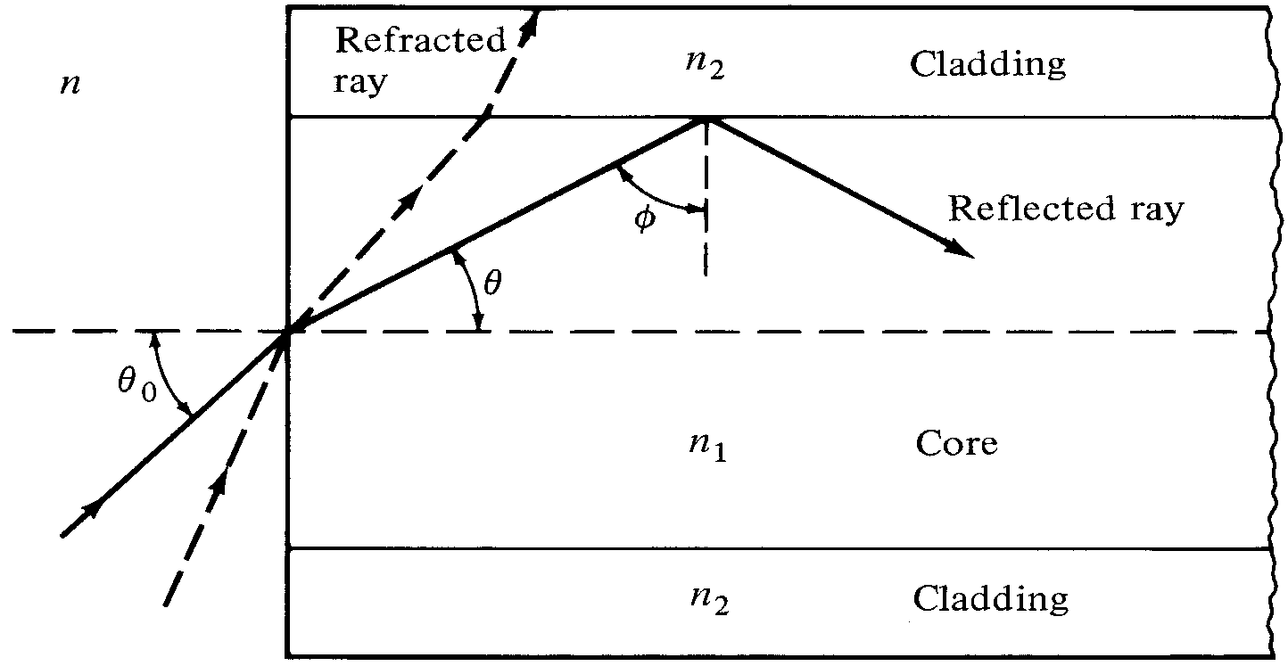
Optical Fiber as a Communication Channel
Basic Laws and Definitions: Refractive Index, Reflection & Refraction

Slide 7
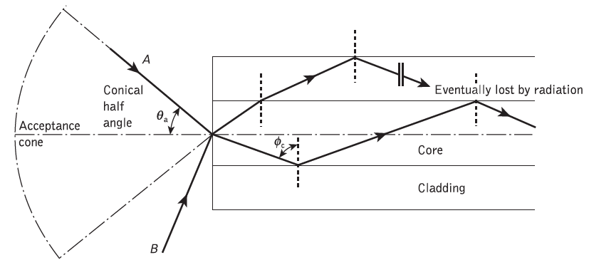
Acceptance Angle
This is the maximum angle to the centre axis of fiber at which light may enter the fiber in order to be propagated

Slide 8
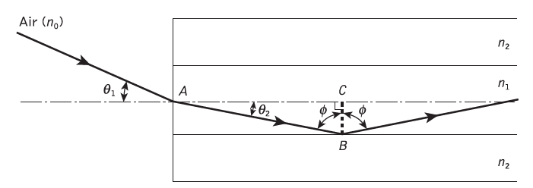
Numerical Apperture
It is important to obtain a relationship between the acceptance angle and the refractive indices of the three media involved, namely the core, cladding and air.

Slide 9




Assuming the entrance face at the fiber core to be normal to the axis, then considering the refraction at the air–core interface and using Snell’s law
Considering the right-angled triangle ABC indicated

Slide 10


When the limiting case for total internal reflection is considered, φ becomes equal to the critical angle for the core–cladding interface
Also in this limiting case θ1 becomes the acceptance angle for the fiber θa.

Slide 11

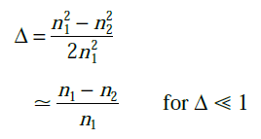

Numerical aperture (NA) is the parameter which relates the acceptance angle to the refractive indices of core and cladding.
The NA may also be given in terms of the relative refractive index difference Δ between the core and the cladding
Numerical aperture is very useful measure of the light-collecting ability of a fiber.

Slide 12
Example 1
A silica optical fiber with a core diameter large enough to be considered by ray theory analysis has a core refractive index of 1.50 and a cladding refractive index of 1.47. Determine:
(a) the critical angle at the core–cladding interface;
(b) the NA for the fiber;
(c) the acceptance angle in air for the fiber.

Slide 13
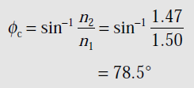


Solution
(a)Critical angle
(b) Numerical Aperture
(c)Acceptance Angle

Slide 14
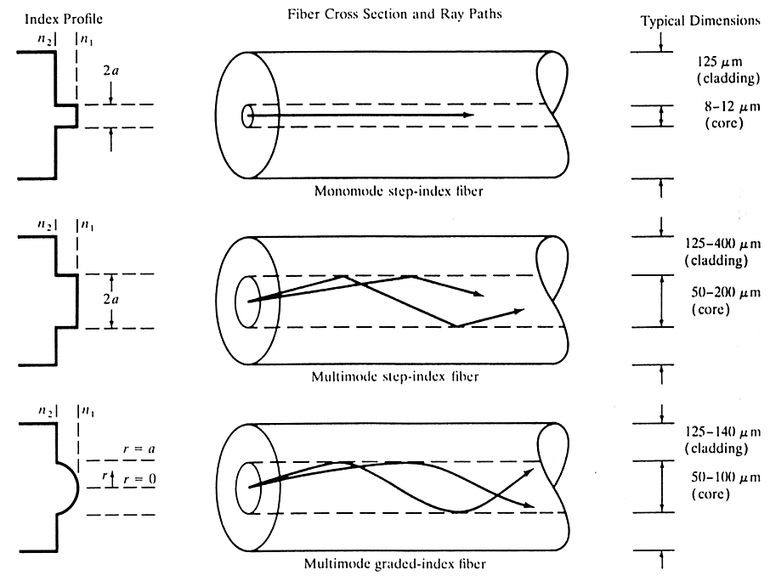
Optical Fiber Modes and Configurations
Fiber Types

Slide 15
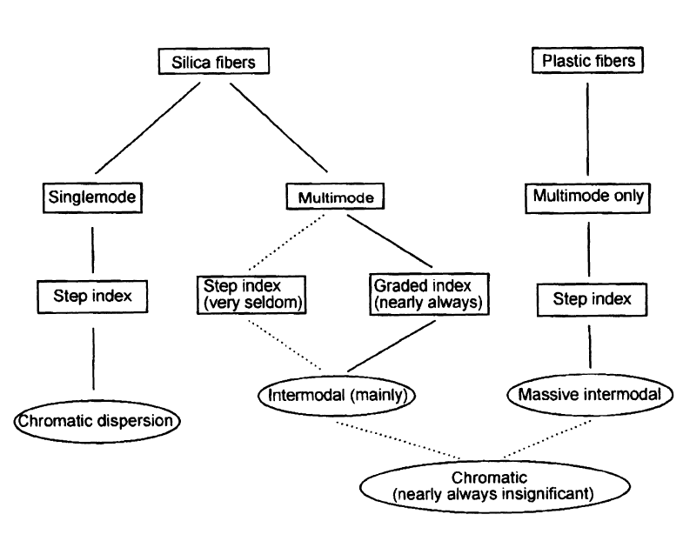

Slide 16
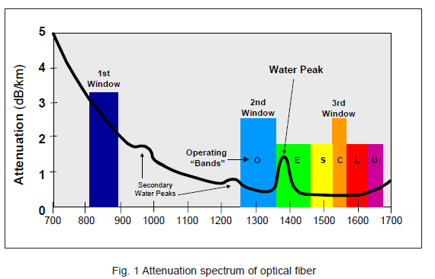
Signal Degradation in Optical Fibers
ATTENUATION

Slide 17
A number of mechanisms are responsible for the signal attenuation within optical fibers.
These mechanisms are influenced by the material composition, the preparation and purification technique, and the waveguide structure.
They may be categorized within several major areas which include material absorption, material scattering (linear and nonlinear scattering), curve and microbending losses, mode coupling radiation losses and losses due to leaky modes.
There are also losses at connectors and splices

Slide 18
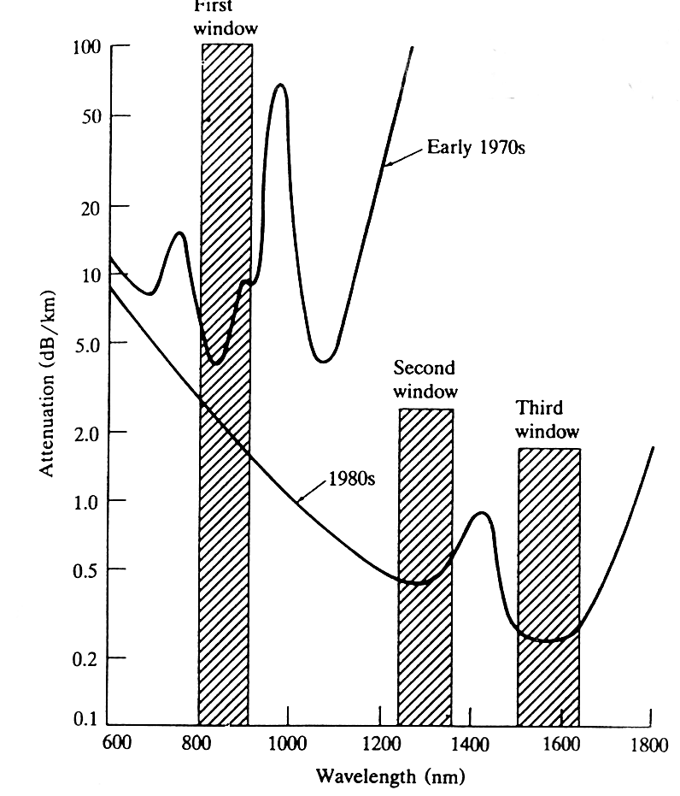
Absorption
Scattering
Bending

Slide 19
Signal Degradation in the Optical Fiber
Signal Attenuation
It determines the maximum unamplified or repeaterless distance between transmitter and receiver.
Has large influence on system cost.
Signal Distortion
Causes optical pulses broaden.
Overlapping with neighboring pulses, creating errors in the receiver output.
It limits the information carrying capacity of a fiber.

Slide 20
Attenuation
The Basic attenuation mechanisms in a fiber:
Absorption:
It is related to the fiber material(atomic defects, extrinsic absorption by impurity atoms in glass or intrinsic absorption by basic constituents atoms of fiber material).
2. Scattering: It is associated both with the fiber material and with the structural imperfections in the optical waveguide.
3. Radiative losses/ Bending losses:
It originates from perturbation (both microscopic and macroscopic) of the fiber geometry.

Slide 21
Material absorption losses in silica glass fibers
Material absorption is a loss mechanism related to the material composition and the fabrication process for the fiber, which results in the dissipation of some of the transmitted optical power as heat in the waveguide.
The absorption of the light may be intrinsic (caused by the interaction with one or more of the major components of the glass) or extrinsic (caused by impurities within the glass).

Slide 22
Linear scattering losses
Linear scattering mechanisms cause the transfer of some or all of the optical power contained within one propagating mode to be transferred linearly (proportionally to the mode power) into a different mode.
This process tends to result in attenuation of the transmitted light as the transfer may be to a leaky or radiation mode which does not continue to propagate within the fiber core, but is radiated from the fiber.
Linear scattering may be categorized into two major types: Rayleigh and Mie scattering.

Slide 23

Rayleigh scattering
Rayleigh scattering is the dominant intrinsic loss mechanism in the low-absorption window between the ultraviolet and infrared absorption tails.
It results from inhomogeneities of a random nature occurring on a small scale compared with the wavelength of the light.
For a single-component glass this is given by
where γR is the Rayleigh scattering coefficient, λ is the optical wavelength, n is the refractive index of the medium, p is the average photoelastic coefficient, βc is the isothermal compressibility at a fictive temperature TF, and K is Boltzmann’s constant.
The fictive temperature is defined as the temperature at which the glass can reach a state of thermal equilibrium and is closely related to the anneal temperature.

Slide 24
Mie scattering
This is the scattering created by inhomogeneities which are comparable in size with the guided wavelength due to nonperfect cylindrical structure of the waveguide.
The inhomogeneities may be reduced by:
(a) removing imperfections due to the glass manufacturing process;
(b) carefully controlled extrusion and coating of the fiber;
(c) increasing the fiber guidance by increasing the relative refractive index difference.

Slide 25
Nonlinear scattering losses
Optical waveguides do not always behave as completely linear channels whose increase in output optical power is directly proportional to the input optical power.
Several nonlinear effects occur, which in the case of scattering cause disproportionate attenuation, usually at high optical power levels
The most important types of nonlinear scattering within optical fibers are stimulated Brillouin and Raman scattering

Slide 26
Stimulated Brillouin scattering
Stimulated Brillouin scattering (SBS) may be regarded as the modulation of light through thermal molecular vibrations within the fiber.
The scattered light appears as upper and lower sidebands which are separated from the incident light by the modulation frequency.
Brillouin scattering is only significant above a threshold power density

Slide 27

It is important to determine the threshold power to be launched in fiber before SBS occur.
where d and λ are the fiber core diameter and the operating wavelength, respectively, both measured in micrometers, αdB is the fiber attenuation in decibels per kilometer and ν is the source bandwidth (i.e. injection laser) in gigahertz

Slide 28
Stimulated Raman scattering
Stimulated Raman scattering (SRS) is a scattering where high-frequency optical phonon generated in the scattering process.
SRS can occur in both the forward and backward directions in an optical fiber, and may have an optical power threshold of up to three orders of magnitude higher than the Brillouin threshold in a particular fiber.

Slide 29

Threshold optical power for SRS PR in a long single-mode fiber is given by:

Slide 30

Dispersion
This is the optical pulse broadening as it travel through the optical fiber
For no overlapping of light pulses down on an optical fiber link the digital bit rate BT must be less than the reciprocal of the broadened (through dispersion) pulse duration (2τ).

Slide 31
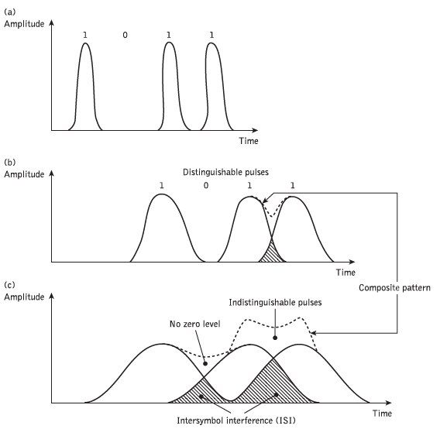

Slide 32
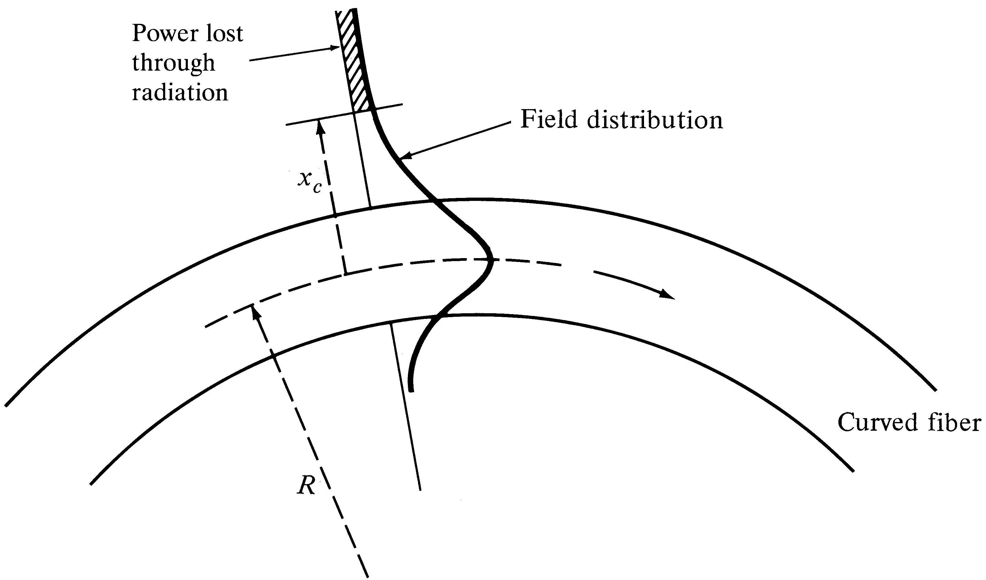
Power loss in a curved fiber
Notes:
5

Slide 33
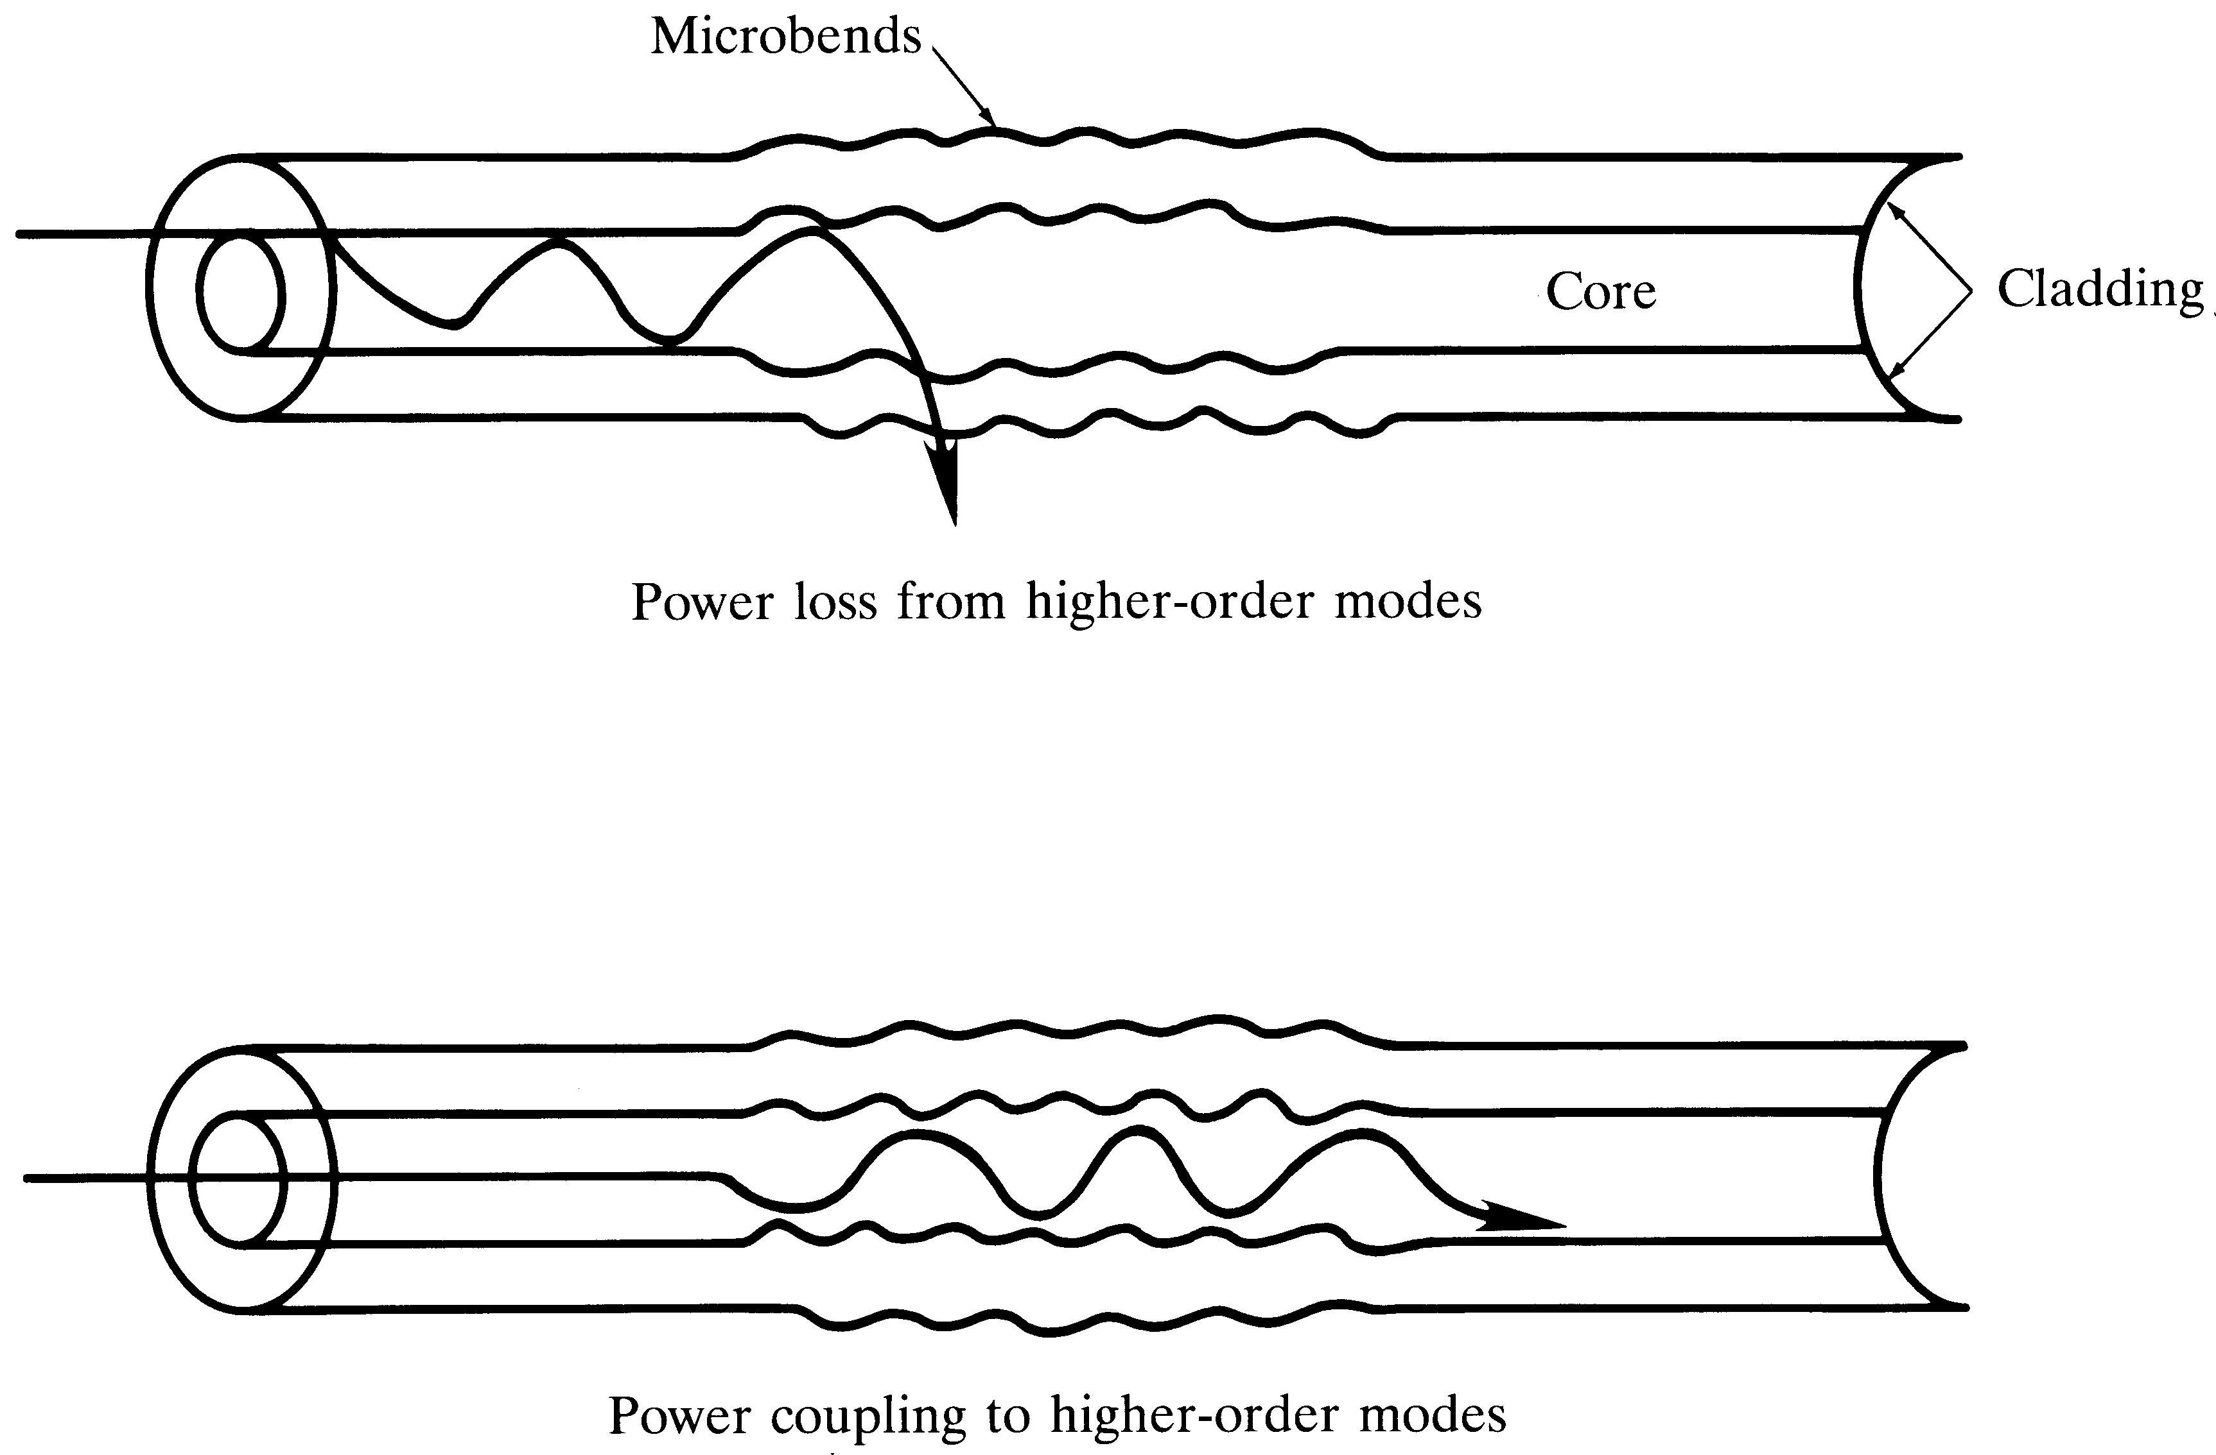
Microbending losses
Notes:
6

Slide 34
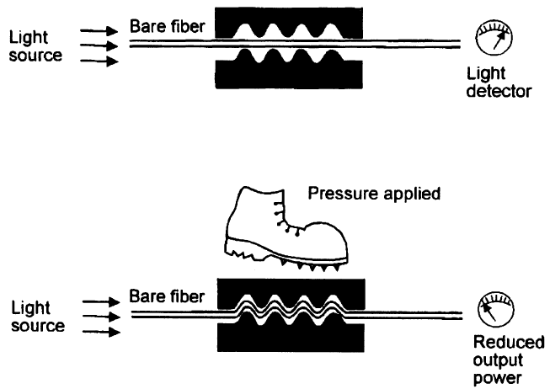
Pressure causes loss at the bends

Slide 35
Signal Distortion in Fibers
Optical signal weakens from attenuation mechanisms and broadens due to distortion effects.
Eventually these two factors will cause neighboring pulses to overlap.
After a certain amount of overlap occurs, the receiver can no longer distinguish the individual adjacent pulses and error arise when interpreting the received signal.

Slide 36
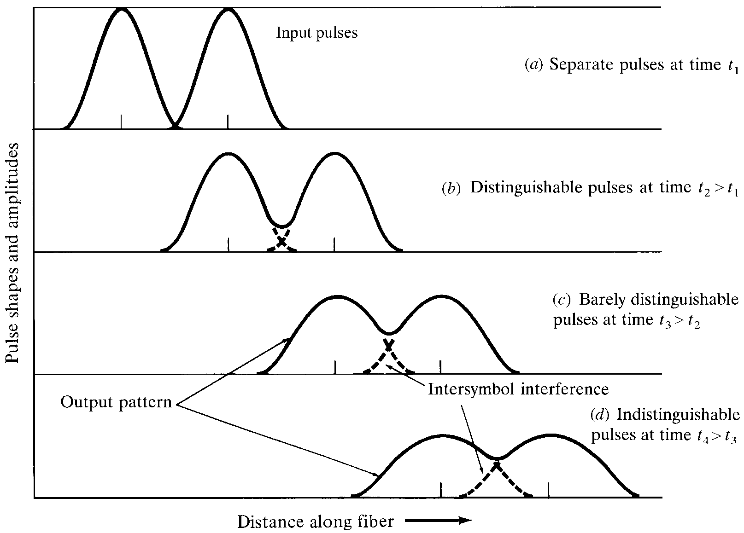
Pulse broadening and attenuation
Notes:
7

Slide 37
Dispersion

Slide 38
Dispersion
Intermodal Dispersion
Intramodal or Chromatic Dispersion:
Material Dispersion
Waveguide Disperion

Slide 39
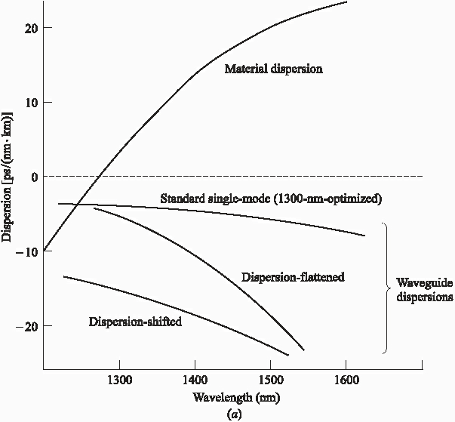
SM-Fiber Dispersions

Slide 40
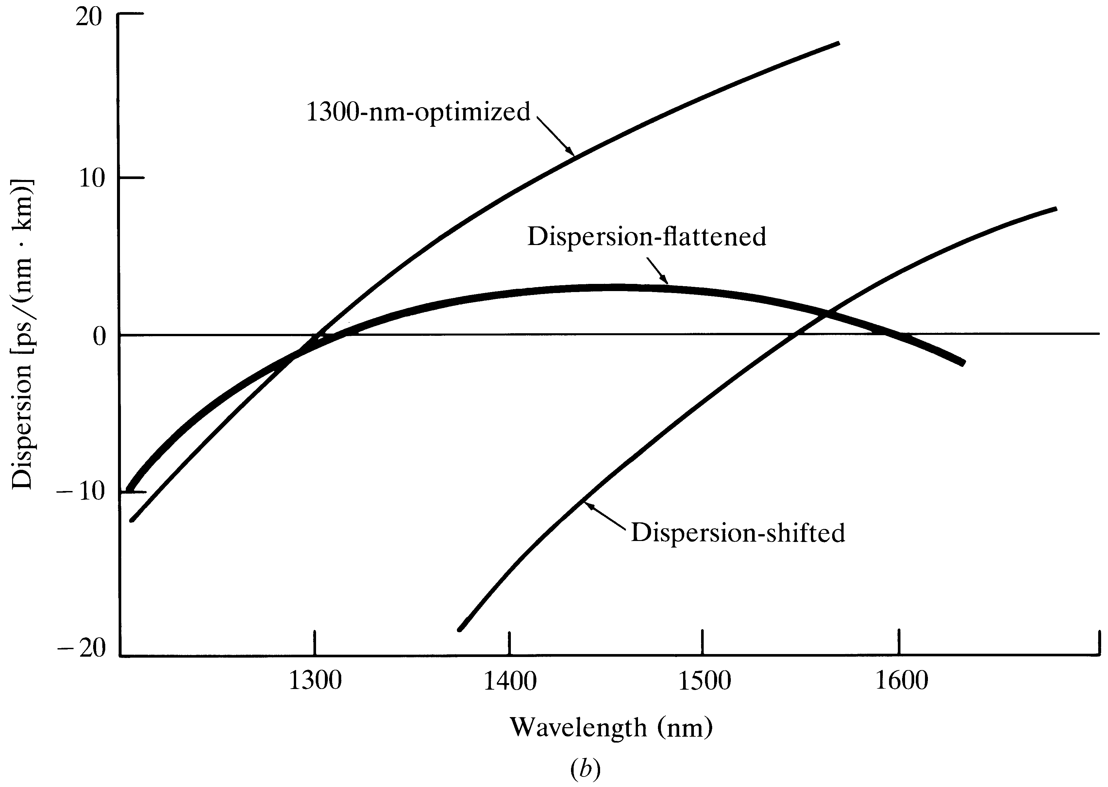
SM-fiber dispersions

Slide 41
Step Index Multi-mode
Graded Index Multi-mode

Slide 42
Intramodal Dispersion or Chromatic Dispersion
Material Dispersion:
This refractive index property causes a wavelength dependence of the group velocity of a given mode; that is,
Pulse spreading occurs even when different wavelength follow the same path.
Material dispersion can be reduced:
Either by choosing sources with narrower spectral output widths OR
By operating at longer wavelengths.

Slide 43
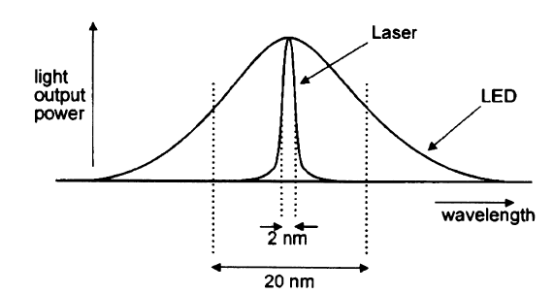
LASER source will produce far less spectral dispersion or intramodal dispersion than an LED source since it is more nearly monochromatic

Slide 44
Signal Degradation
in the Optical Fiber
Signal Distortion/
Dispersion
Attenuation
Absorption
Scattering
Losses
Radiative
losses
Intermodal
Delay/
Modal Delay
Intramodal
Dispersion/
Chromatic
Dispersion
Polarization
-mode
Dispersion
Intrinsic
Absorption
Extrinsic
(Impurity
atoms)
Atomic
Defects
Material
Dispersion
Waveguide
Dispersion
Absorption
in
Infrared
region
Absorption
in
Ultraviolet
region
Inhomogeneities
or defects
in fiber
Compositional
fluctuations
in material
Microscopic
bends
Macroscopic
bends

Slide 45
THANK YOU

